Slide 1
SOURCE CODING THEOREMS I & II

Slide 2
Source coding
Definition
Conversion of the o/p of a discrete memoryless source(DMS) into a sequence of binary symbols (ie binary codeword).
Device that performs this conversion – source encoder.

Slide 3
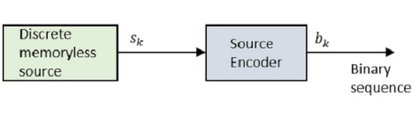

Slide 4
Objective
To minimize avg bit rate required for representation of the source by reducing the redundancy of the information source.
Terms related to Source coding process
Codeword length
Average codeword length ($\overline{L}$)
Code efficiency
Code redundancy

Slide 5
Source Coding theorem I
S_{k} is the discrete memory less source output and the b_{k} is the source encoder output which is represented by 0s and 1s.
The encoded sequence is easily decoded at the receiver.

Slide 6
Consider the source has an alphabet with k different symbols and the k^{th} symbol S_{k} occurs with the probability P_{k}, where k = 0, 1…k-1.
S_{k} is assigned with binary code word b_{k}, by the encoder having length l_{k}, is measured in bits.
The average code word length $\overline{L}$ of the source encoder is defined as
$\overline{L}$ = $\sum_{k=0}^{k−1}{\text{p}\text{k}\text{I}\text{k}}$
$\overline{L}$represents the average number of bits per source symbol

Slide 7
If L_{min}=minimum possible value of $\overline{L}$, then coding efficiency is defined as
$η=\frac{\text{L}\text{min}}{\overline{L}}$
With $\overline{L}≥L_{min}$, we will have $η$ $≤1$
when $η$ approaches unity, the code is said to be efficient (source encoder is efficient when η=1).
For this, the value L_{min} has to be determined.

Slide 8
Given a discrete memory less source of entropy H(S), the average code-word length $\overline{L }$ for any source encoding can bounded as $\overline{L }$ $≥H(S)$.
In simple terms, the code word is always greater than or equal to the source code. Code word symbols are greater than or equal to the source code alphabets.

Slide 9
Therefore with L_{min}=H(S), the source encoder efficiency in terms of Entropy H(S) can be written as
η = H(S)/ $\overline{L }$
This is known as noiseless coding theorem as it provides encoding which is error-free, also known as Shannon’s first theorem.

Slide 10
Code redundancy
$γ=1 − η$
By increasing redundancy of encoding, we can make the prob of error approach 0.

Slide 11
Source Coding theorem II
Let there be a discrete memory less source with entropy H(S).
It is always possible to find a q-ary prefix code such that the expected value of the length of the code words $\overline{L}$ allocated to the sequences of L source symbols satisfies:
$\frac{H\left(S\right)}{\log{q}}≤\overline{L}<\frac{H\left(S\right)}{\log{q}}$ + $1/L$

Slide 12
Numericals

Slide 13
Q1: An analog s/g is expressed by the following eqn. Calculate Nyquist rate for this s/g.

Slide 14
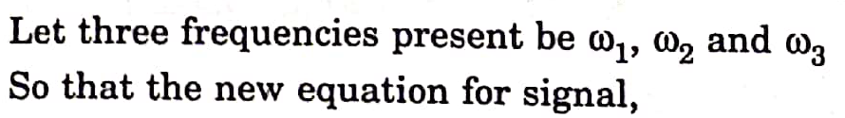
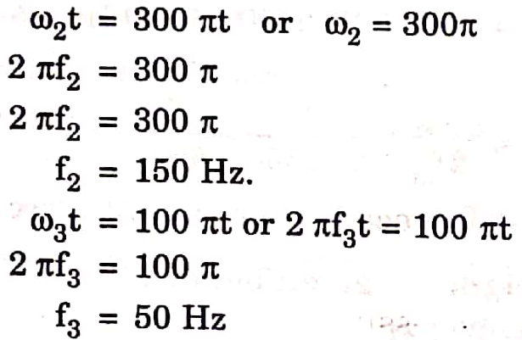
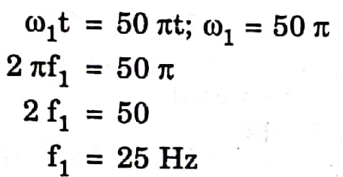
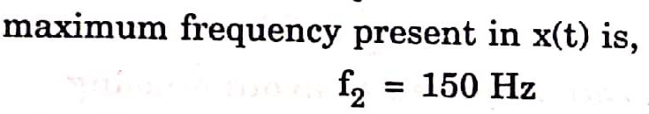



Slide 15
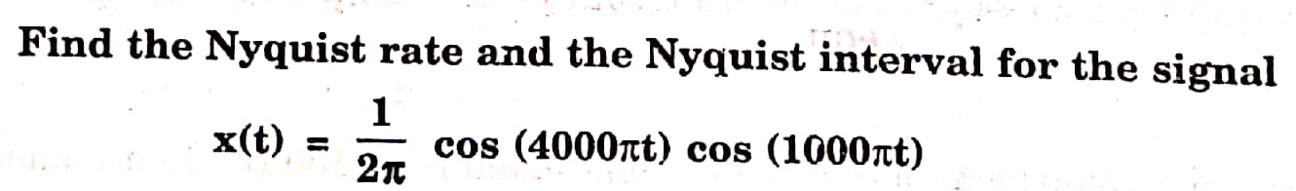
Q2: Find Nyquist rate and Nyquist interval for the signal

Slide 16
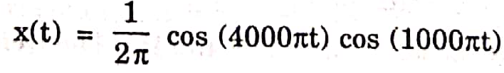
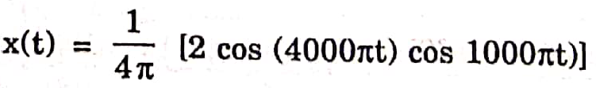

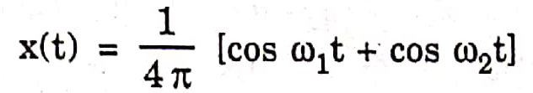
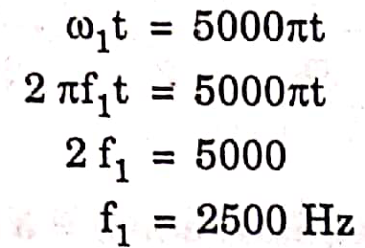

Slide 17
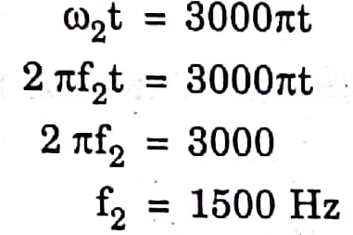
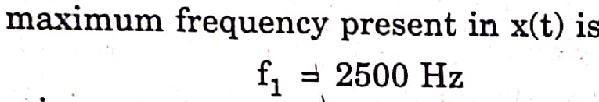



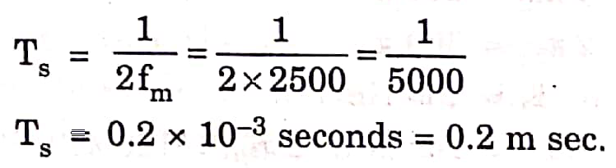

Slide 18
A delta modulator is tested with a 10 kHz sinusodial signal, 1 V peak to peak at input. The signal applied is sampled 10 times the nyquist rate, then what is the minimum step size required to prevent slope overload?

Slide 19
f_{s}=10 f_{n}= 10×2f_{m}=200 kHz
$\frac{∆}{\text{T}\text{s}}$ $≥\max{|\frac{d}{dt}x\left(t\right)|}$
Δ f_{s} ≥ 2πf_{m} A_{m}
Δ ≥ {2π×(10×10³)×0.5 }/ 200 kHz Δ ≥0.157 Volts

Slide 20
A delta modulated system is designed to operate 5 times the Nyquist rate for a signal with 3 kHz bandwidth. The quantization step size is 250 mV. Calculate the maximum amplitude of a 2 kHz input sinusoidal for which the delta modulator does not show slope overload.

Slide 21
Max freq in s/g f_{m} = 3KHz
Nyquist rate f_{N} = 2f_{m} = 6KHz
sampling freq f_{s}= 5 f_{N}
Δ f_{s} ≥ 2πf_{m} A_{m}
Given Δ
f_{m} =2KHz values
Find A_{m}
A_{m} $≤0.6 V$

Slide 22
Compute the step size for a delta modulator without slope overload if the input is 4cos 2π120t

Slide 23
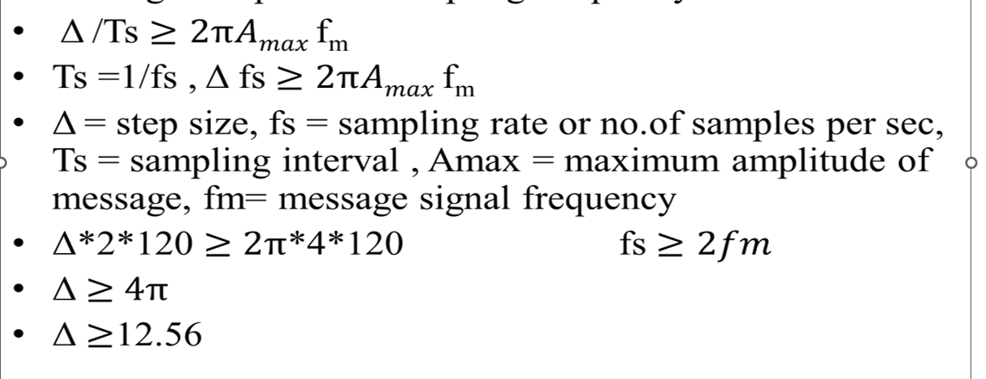

Slide 24
Find the minimum sampling frequency (fs)min required to avoid slope overload when x(t) = cos(2π800t) and Δ = 0.1?

Slide 25
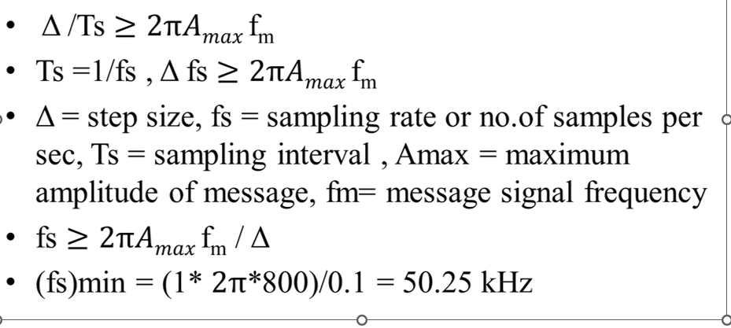

Slide 26
Input to the DM is m(t)=cos2πf_{m}t. Step size is 0.628V. Sampling rate is 40,000 samples/sec. Find the frequency at which the slope overload distortion occurs?

Slide 27
Δ f_{s} < 2π𝐴_{m}f_{m}
0.628× 40000< 2π𝐴_{m}f_{m}
f_{m} > 0.628× 40000/2π*1
f_{m} > 4kHz

